Slide 1
Process Porfolio
Silvia Cai

Slide 2
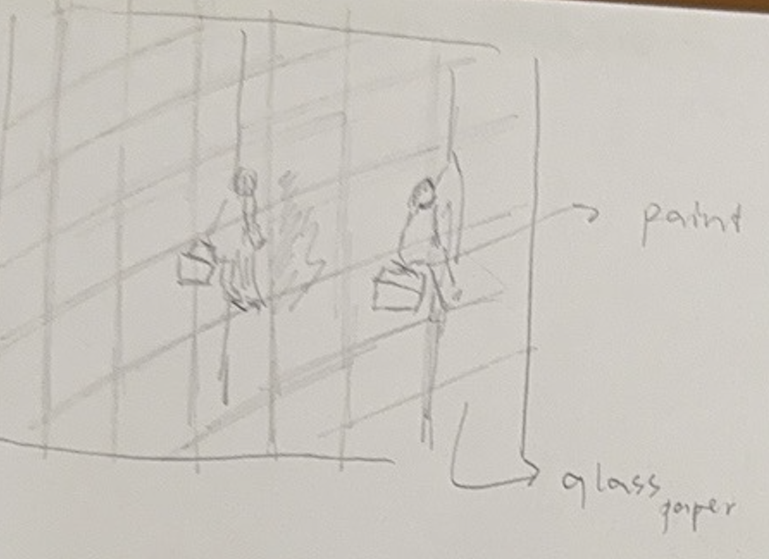
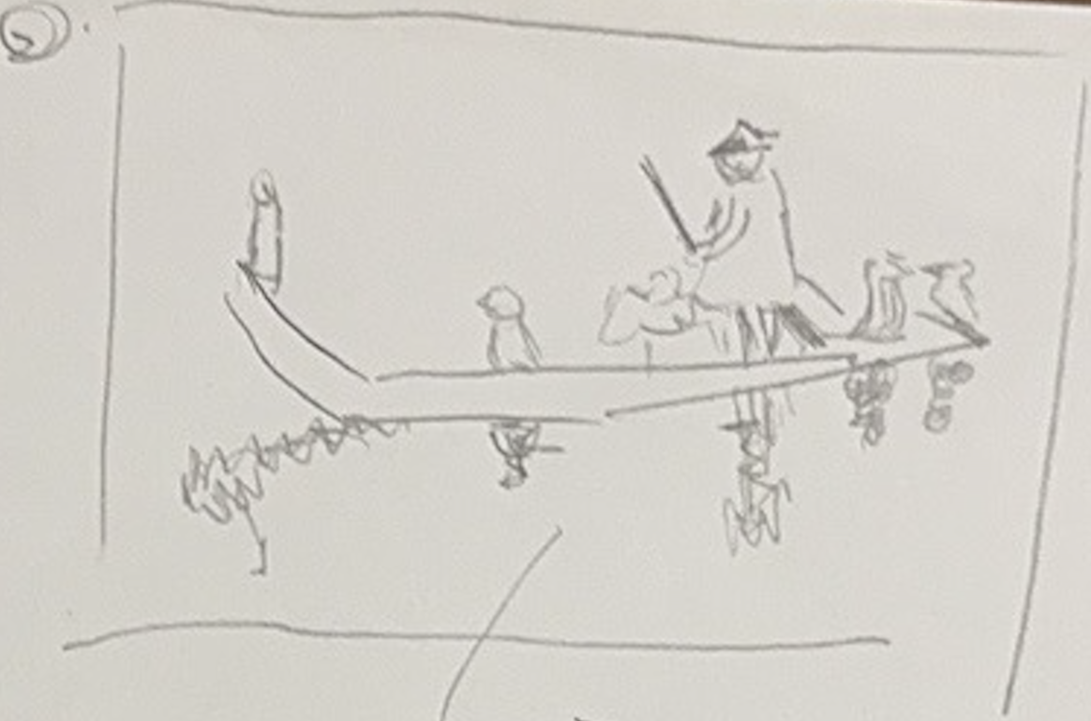
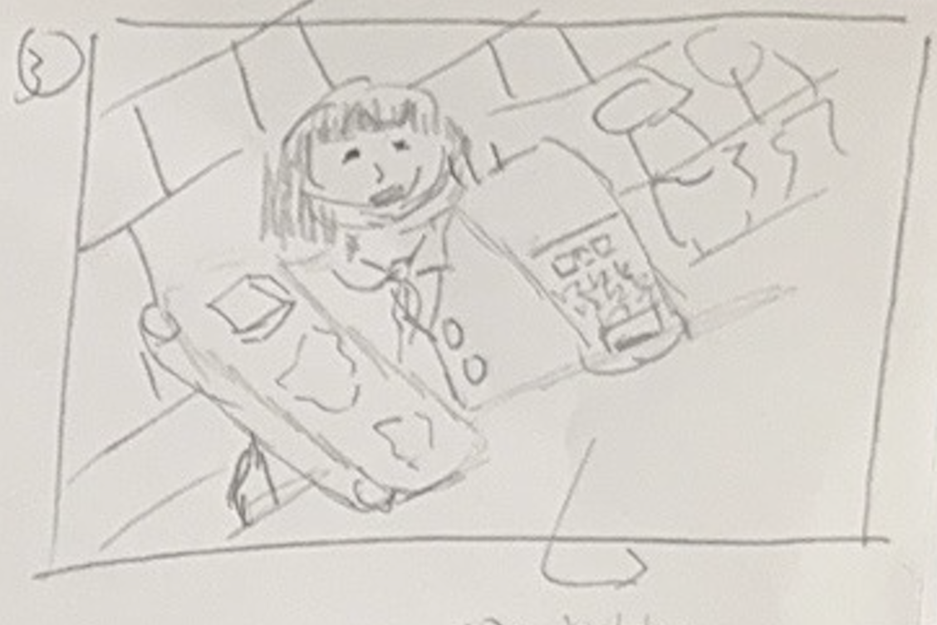
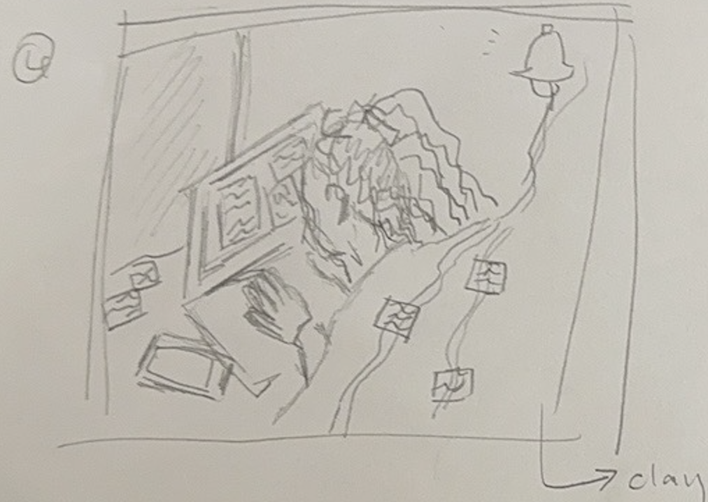
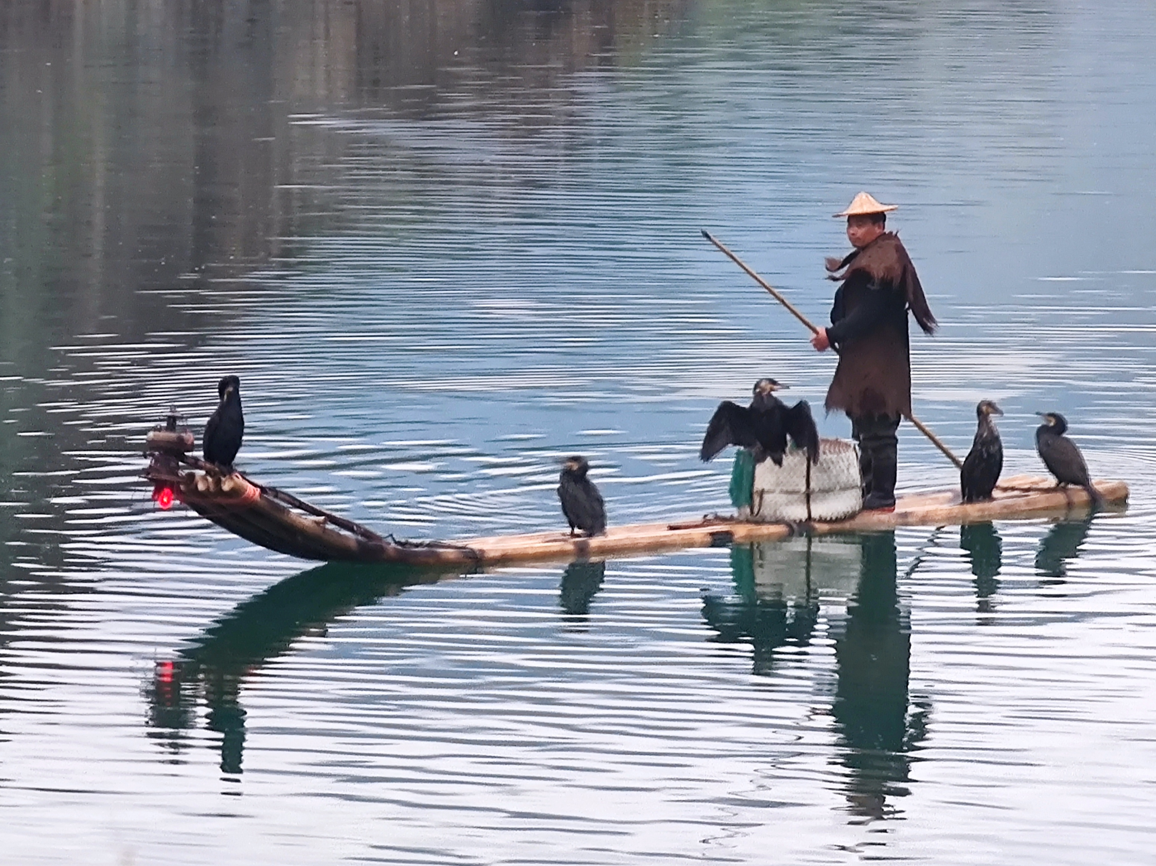
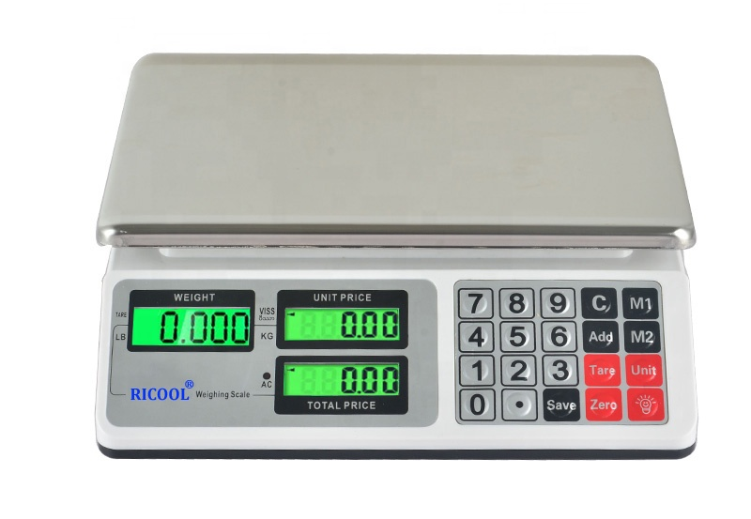
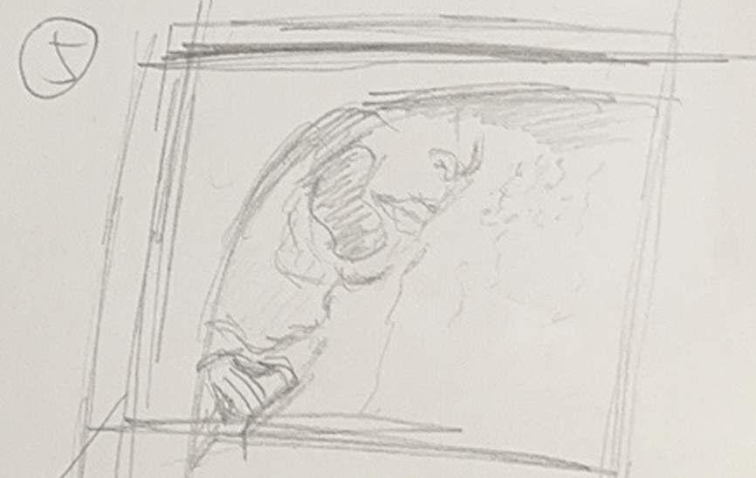
IDEA EXPLORATION (INITIAL AND REVISED SKETCHES)
Communicating my idea:
• the theme of my artist is about working class in the 1880, so I choose to present people working today, addressing different opinion and lifestyle that people have today. Some of the sketches present the feeling of clam and harmony other might present the working pressure that people have, and the suffocated feeling of fast speed life. The final idea that I had chose is idea 5, I used different elements and methods to present working load that people are facing.
Idea 2: I drew a fisherman on a boat, it creates a contrast with nowadays people’s working load, the piece is creating a clam and relax feeling, it will be presented in form of painting, the overall color tone of these piece could be brown, and dark blue. Referencing to the photo below
Idea 1: I drew glass cleaner working on skyscraper, it shows working class today, the extreme workload that they have and the high danger of their working conditions. On the background can be presented by glass paper, to present the reflective glass, and people working can be presented using painting.
Idea 3: the third idea, the cashier is at the center of the piece, both arms of the women are metaphorized, that the left arm is the paddle that products are passing and going to consumers, and on the right arms is presented by the machine combing the calculator with the balance for measuring the wight of the meat, vegetables and fruits.
Reference to the
picture below :
Idea 5: 3D composition of people working during the night, the work will never get the end, showing that in most of the company in china have a very extreme working load pushed on workers.
Idea 4: people are using public transportation, this piece show, the metro is full of people in morning when people are going to work. In the sketch is showing people’s face attached on the window it will be presented by painting, and glass placed in the front of the paint representing the door of the metro, and glue can be putted on the glass to present the liquid condensed. Because of the different temperature in and out of the metro.
It will be represented by clay, the bell on the right angle of the sketch shows the emergency of these work should be done, but the paper is showing that after a work done there will be others and it will never end. With using 3D composition and putting the elements in a box, convey an idea of worker closed in a room with work that they would never be able to finish.

Slide 3
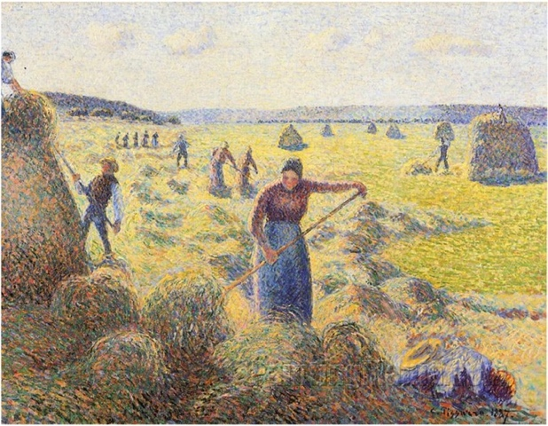
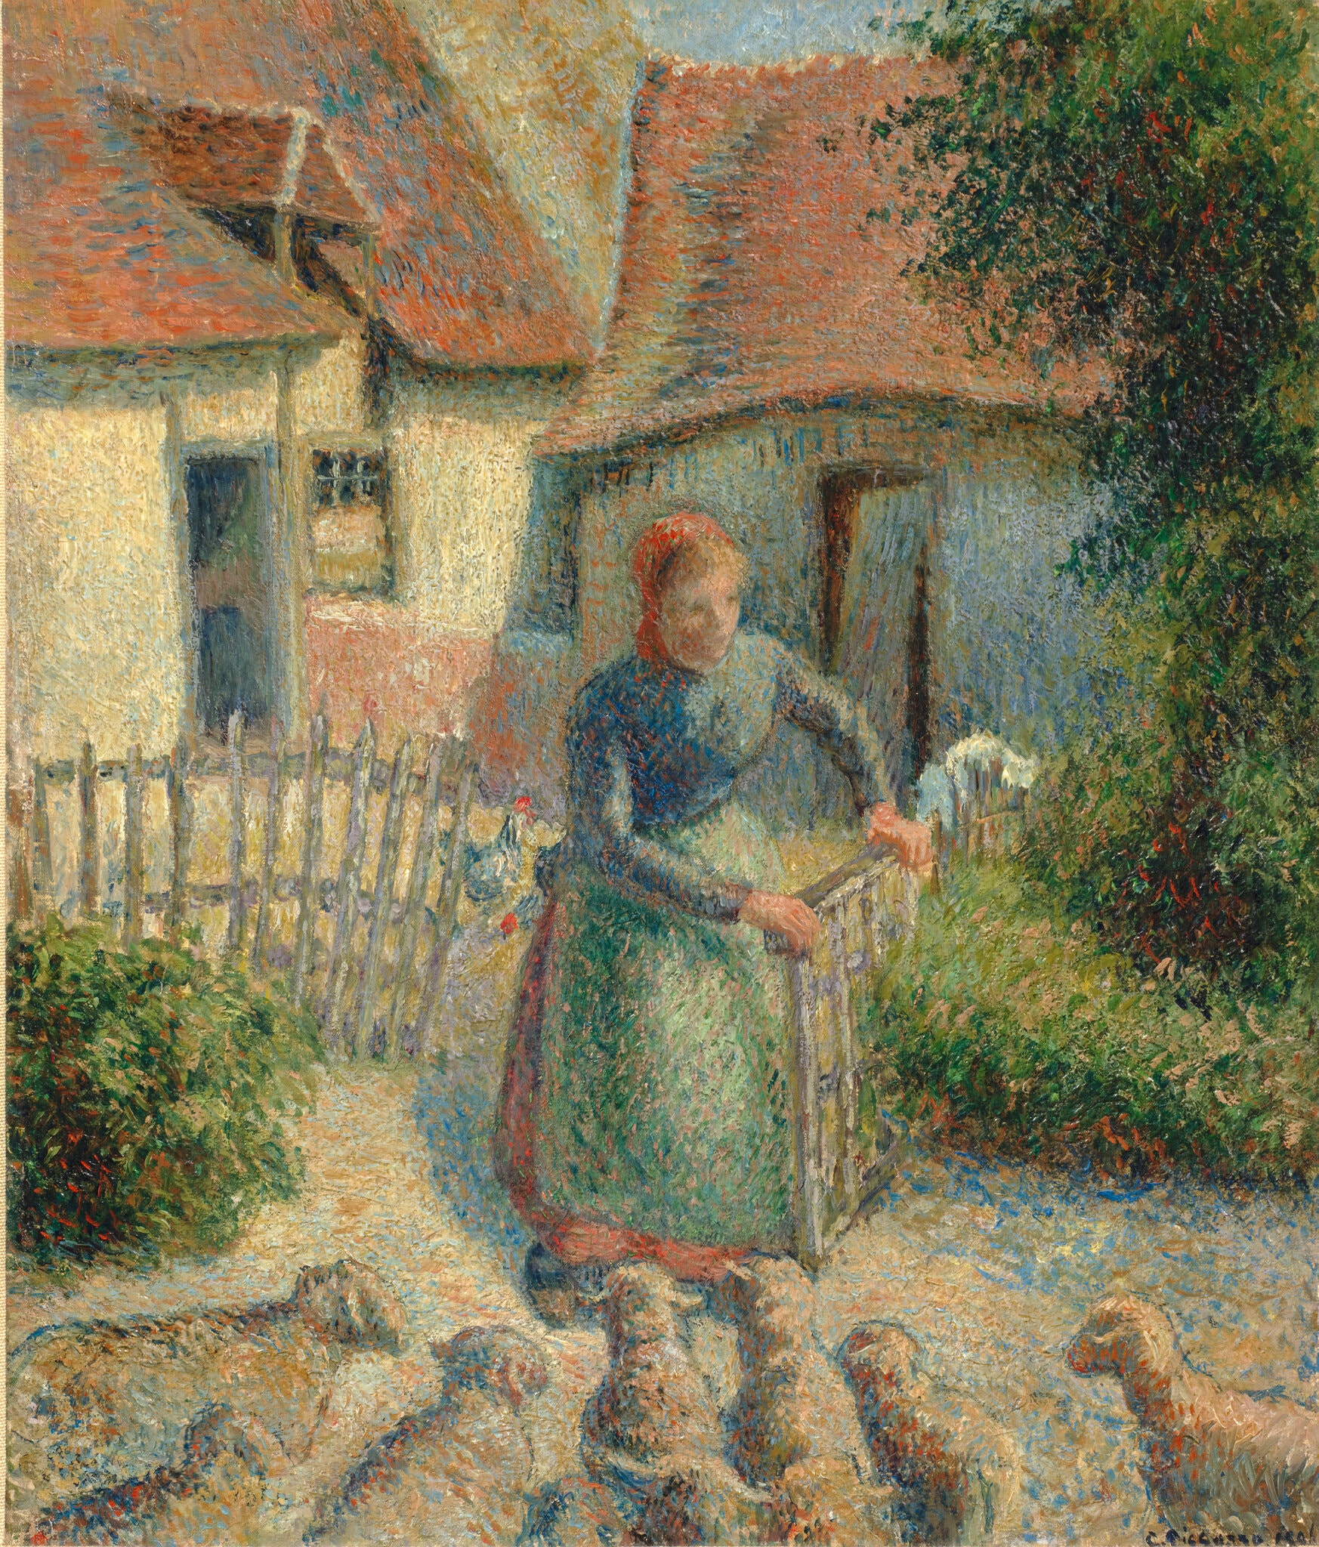
ARTIST RESEARCH
I chose the artworks made by Camille Pissarro, with a central theme of life of the peasant women during his time (1880-1900), especially focus on the harvest season, the most important time for people every year.
I leaned that women are the main work force in the time, even for things like harvest. From the research I find out that the industrialization happened before these paintings are being done, but in the painting, we don’t observe many signs of machine or factories. We can know that the true lifestyle at the county side of north France. They are not affected by the industrialization, so the pace of living was still tranquil.
Pissarro’s intention of painting the life of peasant, we also say the lower-class people, is to educate the public in realistic setting without any idealization in his paintings. At the time he’s clients are so-called the upper-class people. There is no political message in his painting, but just humble subjects of common life to be seen by the rich people.
At first glance you will see a woman with a hay folk in the center of the painting, she is working, her hay folk is pointing down, she is making haystack. There are many haystacks in the foreground of the painting, they are represented with many different colors doted, the main color of the stacks is dark. There is also another person squat in the foreground, compared with the women in the center the person squat at the angle is less detailed, the person at the angle cannot be observed in the first glance. There are also other people in the mid ground you can see two people on the right hand side of the paint they on of the people is standing next to the haystack and there is another person standing at the top of the haystack, those two people might collaborate for managing the haystack. Background we can also see some people and haystacks, the size of these people is much smaller because they are distanced. We can also see there is mountains and sky, it takes a weight of 1/4 about the whole painting.

Slide 4
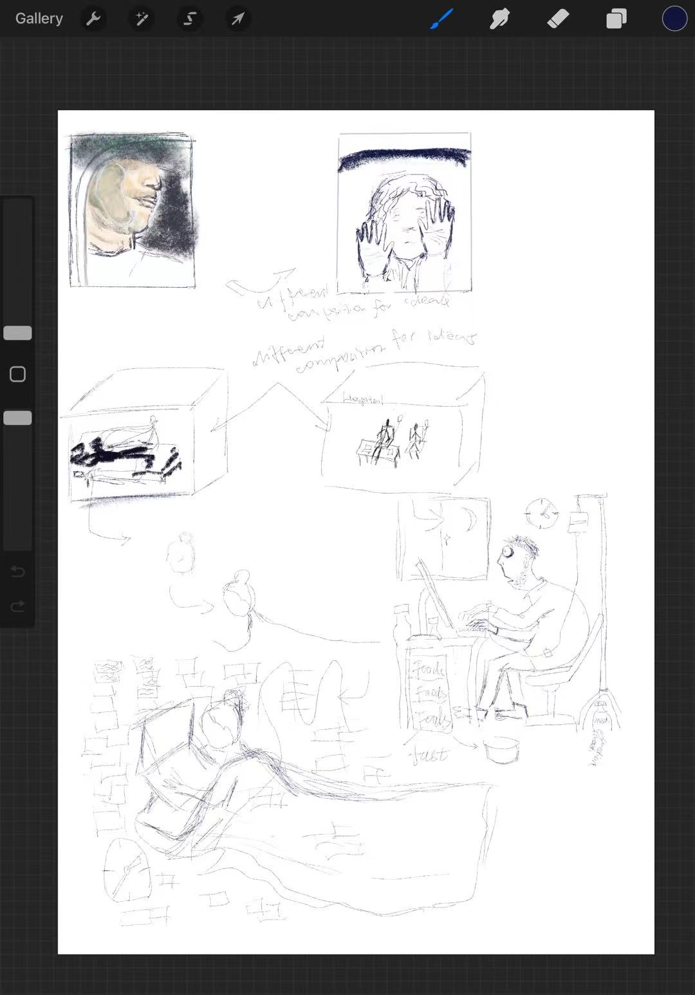
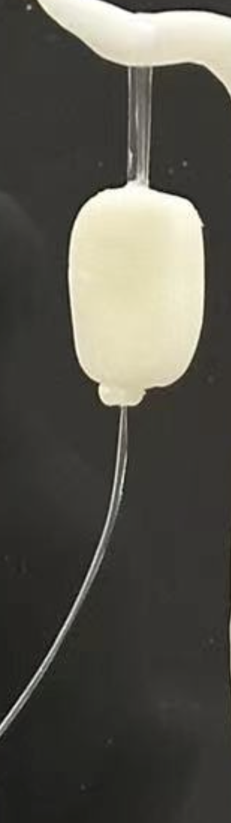
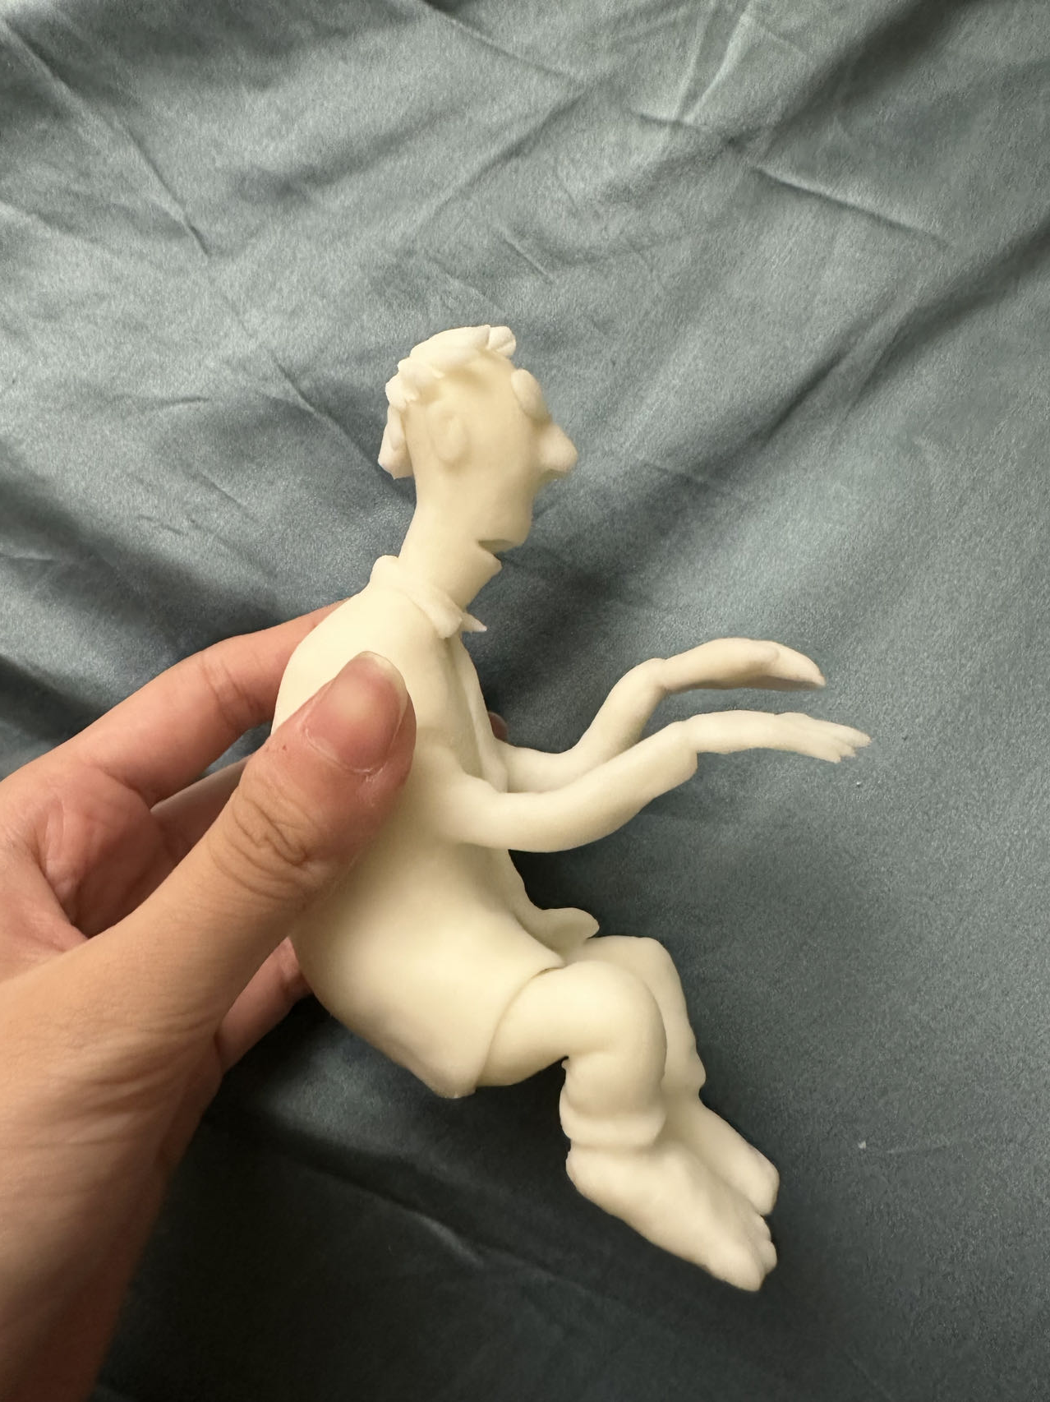
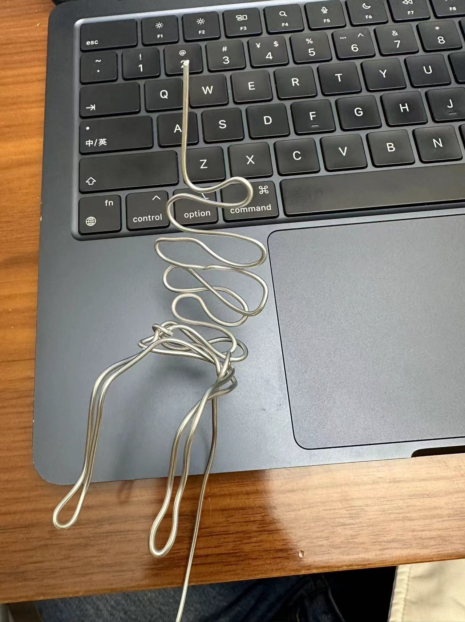
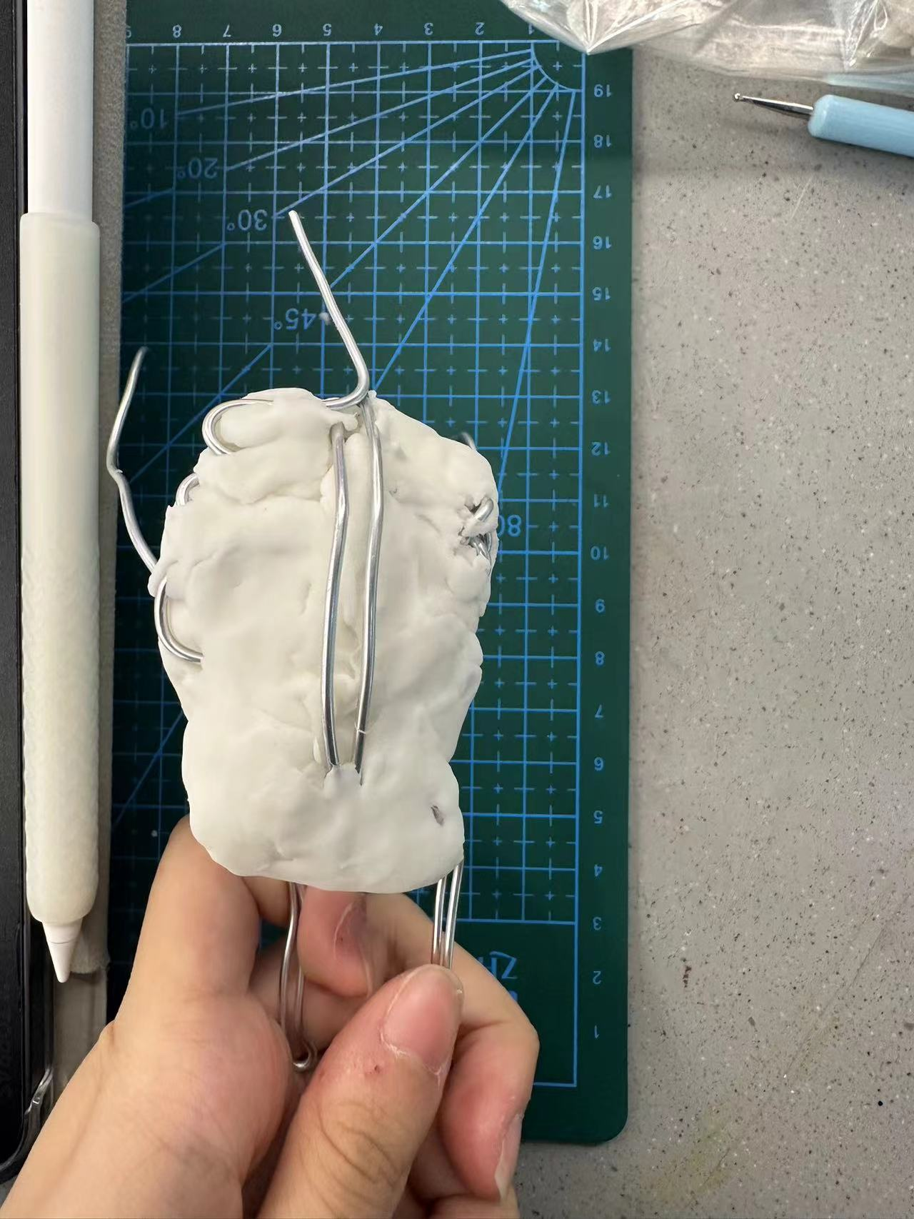
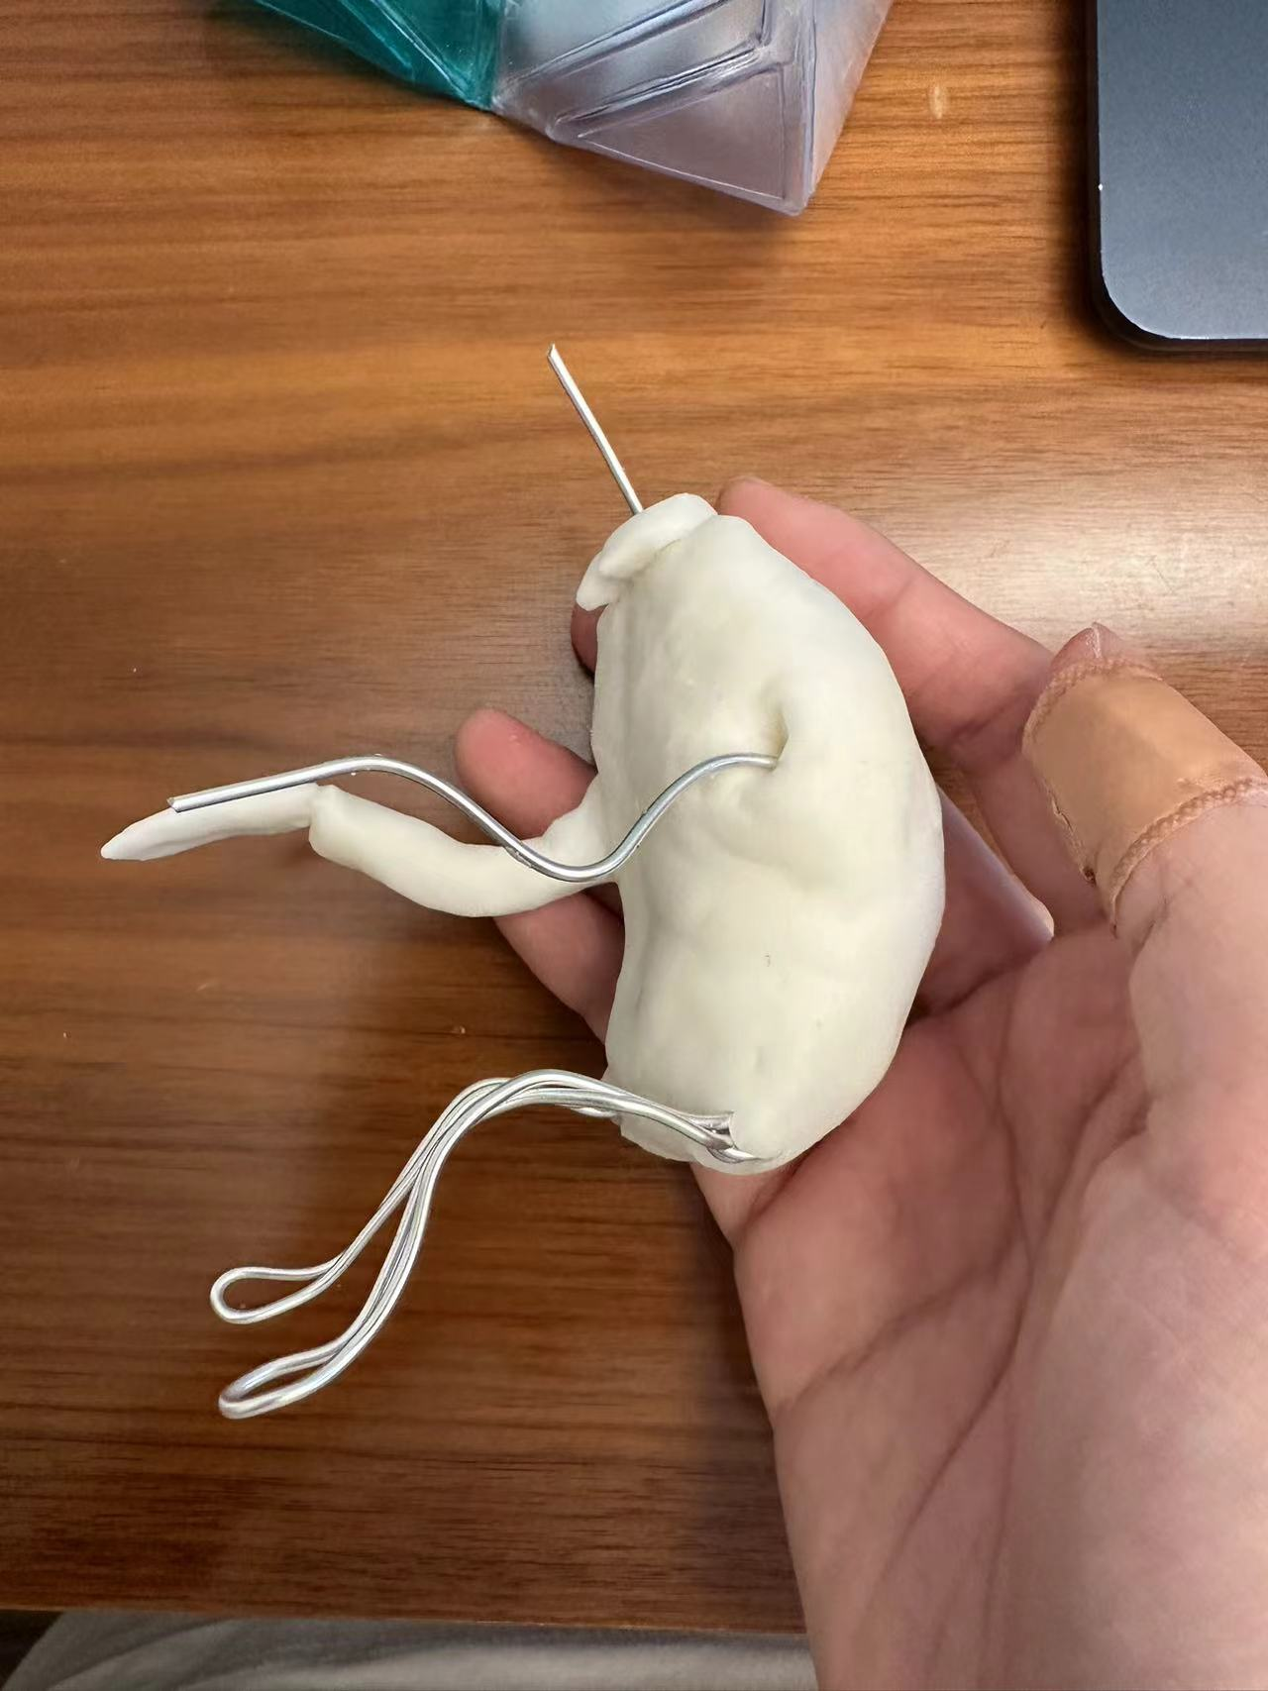
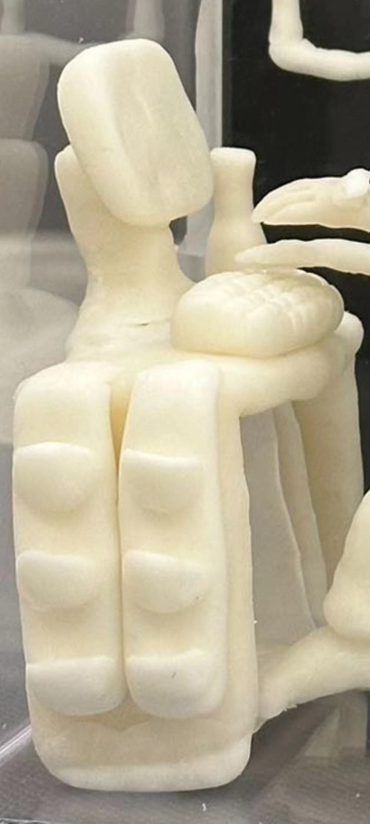
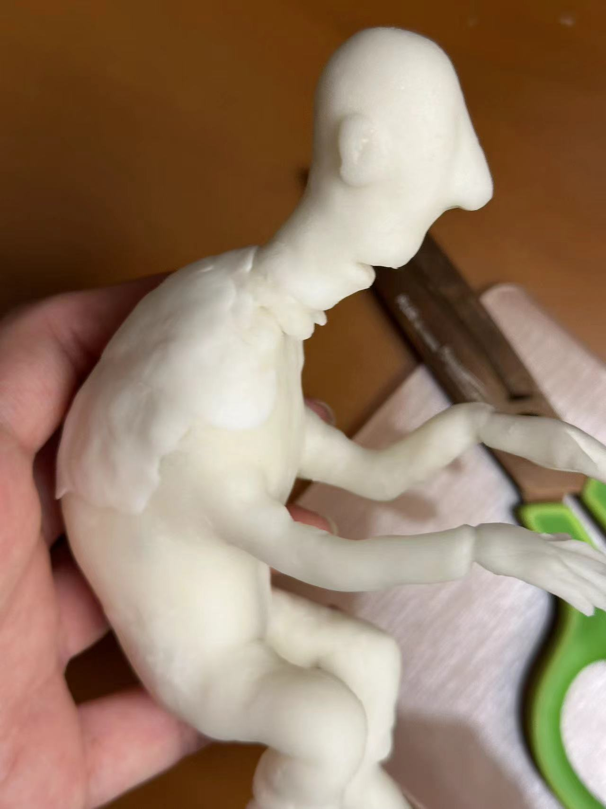
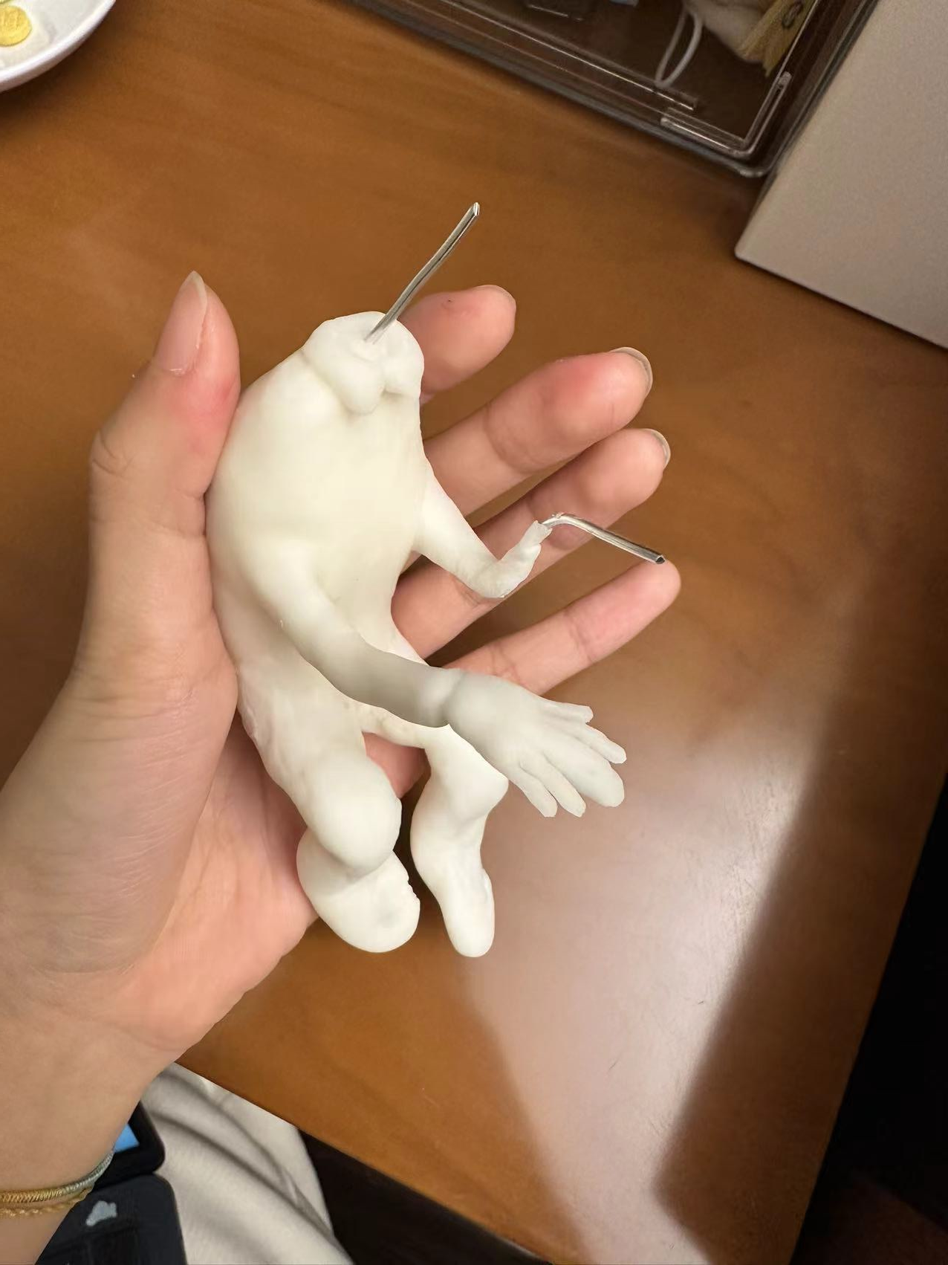
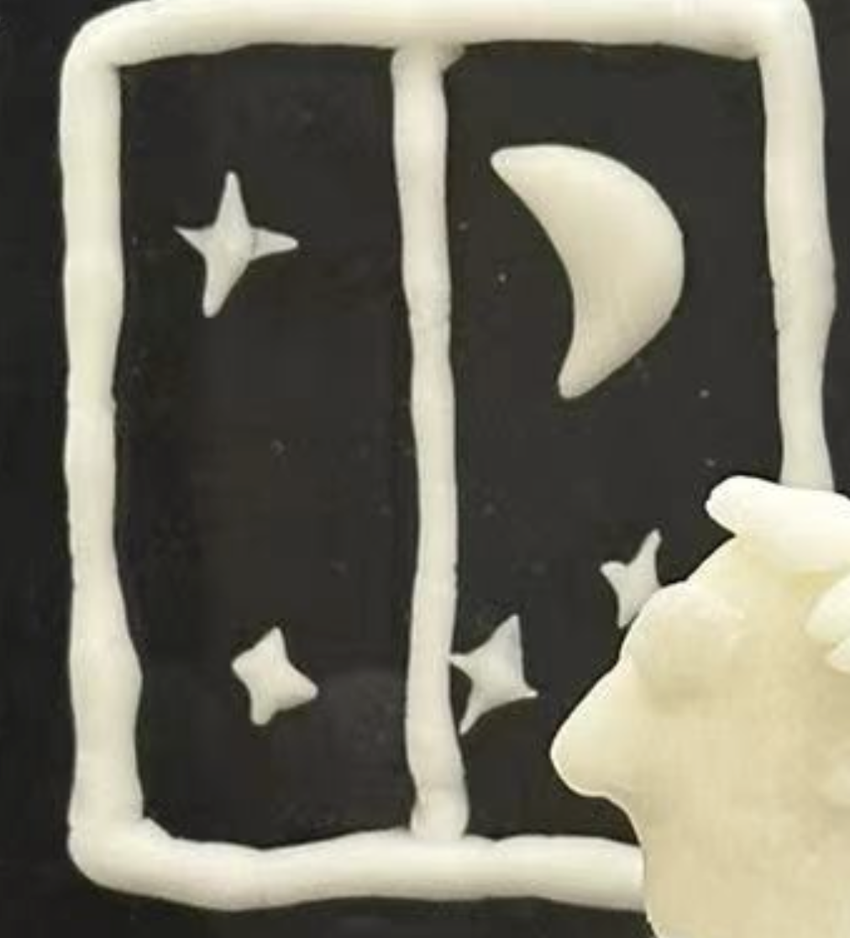
PROCESSING
Two different composition for the forth idea and two different composition for the fifth idea, finally we chose the idea that the worker is sitting in front of the computer working.
I first finished the person. And then starting to do the elements or objects that creates the feeling of heavy work load and the feeling of exhausted.
For the intravenous drip at first I used the clay to create the tube, but then I realize that is hard to be maintained on the drip stand, I tried to use plastic straw to present the transparent tube of the drip. I cut the straw in to small strips and used the clay to create the intravenous bag. It looks better. The table, the computer, the keyboard is all created by the clay. After putting the table the computer and the keyboard together I realize that the table is a little weak to support all the stuff putted on the table. Is should have to put wire in the table. Because the background of my box is black so I chose to make the window of the room directly on the back of the box.
For mantian the human structure I used wire to make the neck, the back, and the legs of the person, I used another wire to make the hand base.
I used the clay to cover the wire structure, after covering all the wires. I smooth the surface of the clay to create more details, his cloth, his hand, his toes and his fingers.
In the process of making the body the head, the clay often dryout so I put little water to be able to work on it, tooked a long time to make the body of the person .

Slide 5
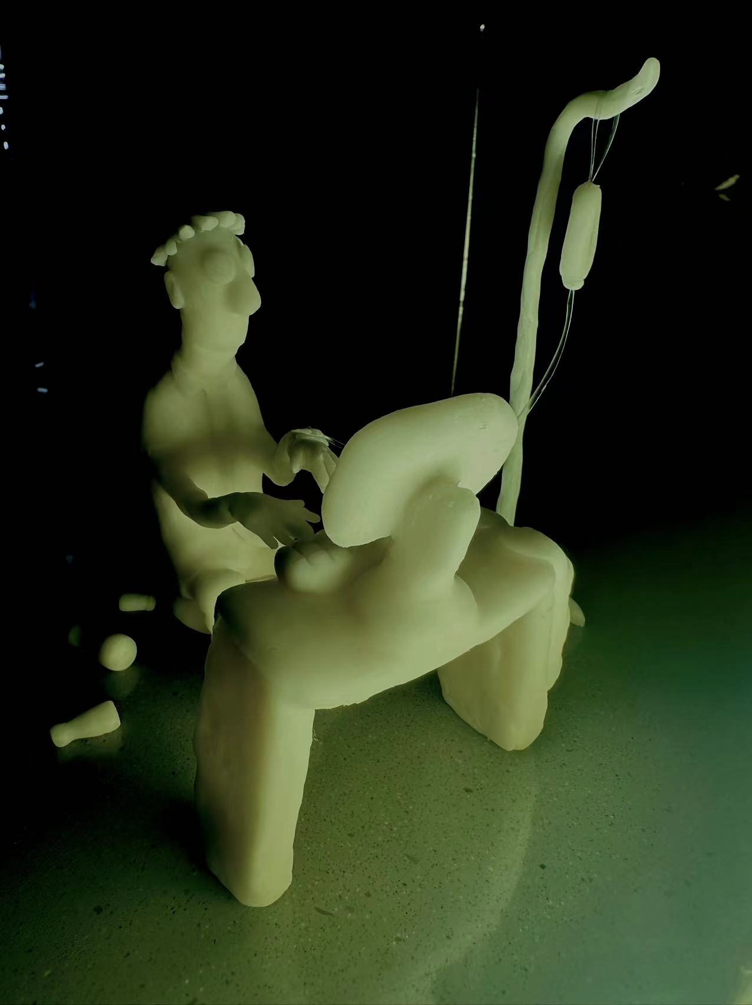
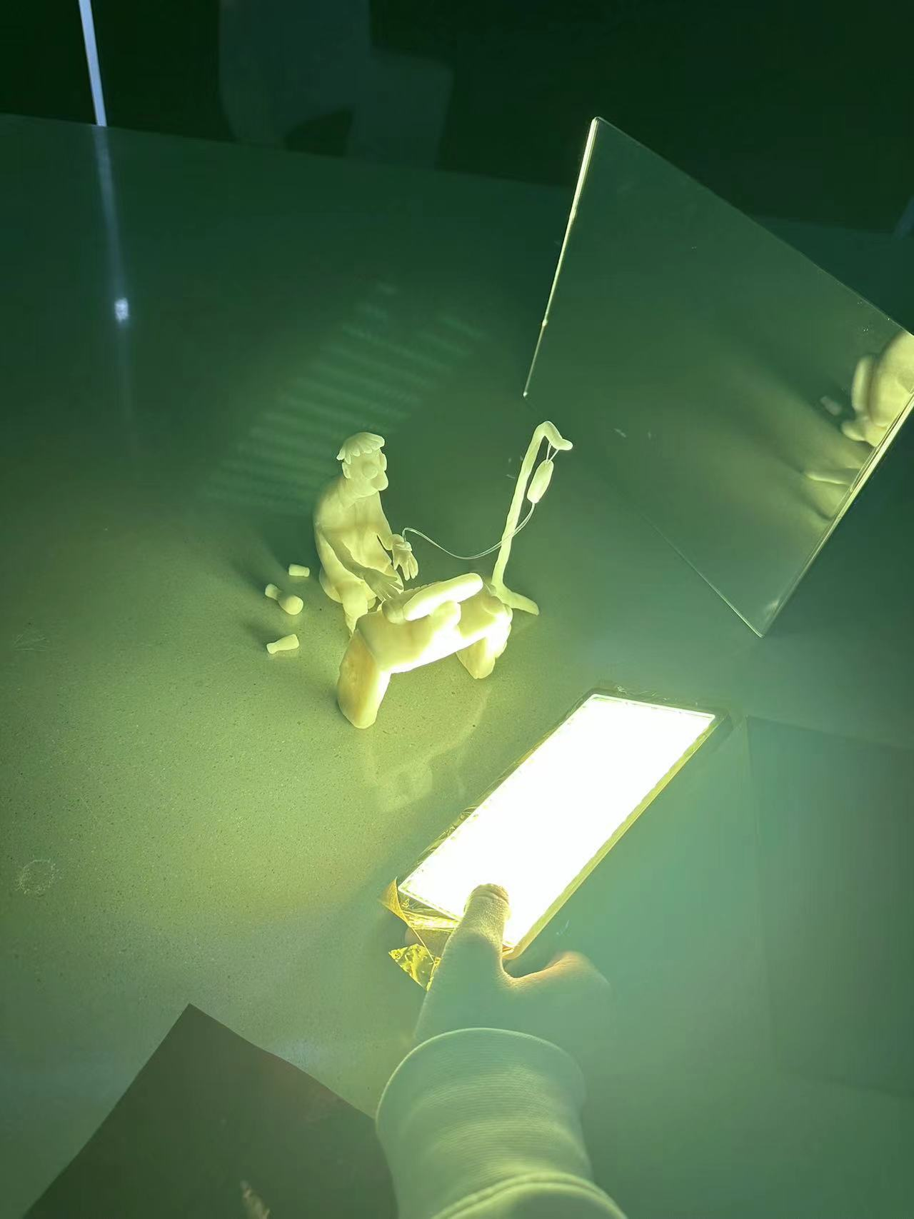
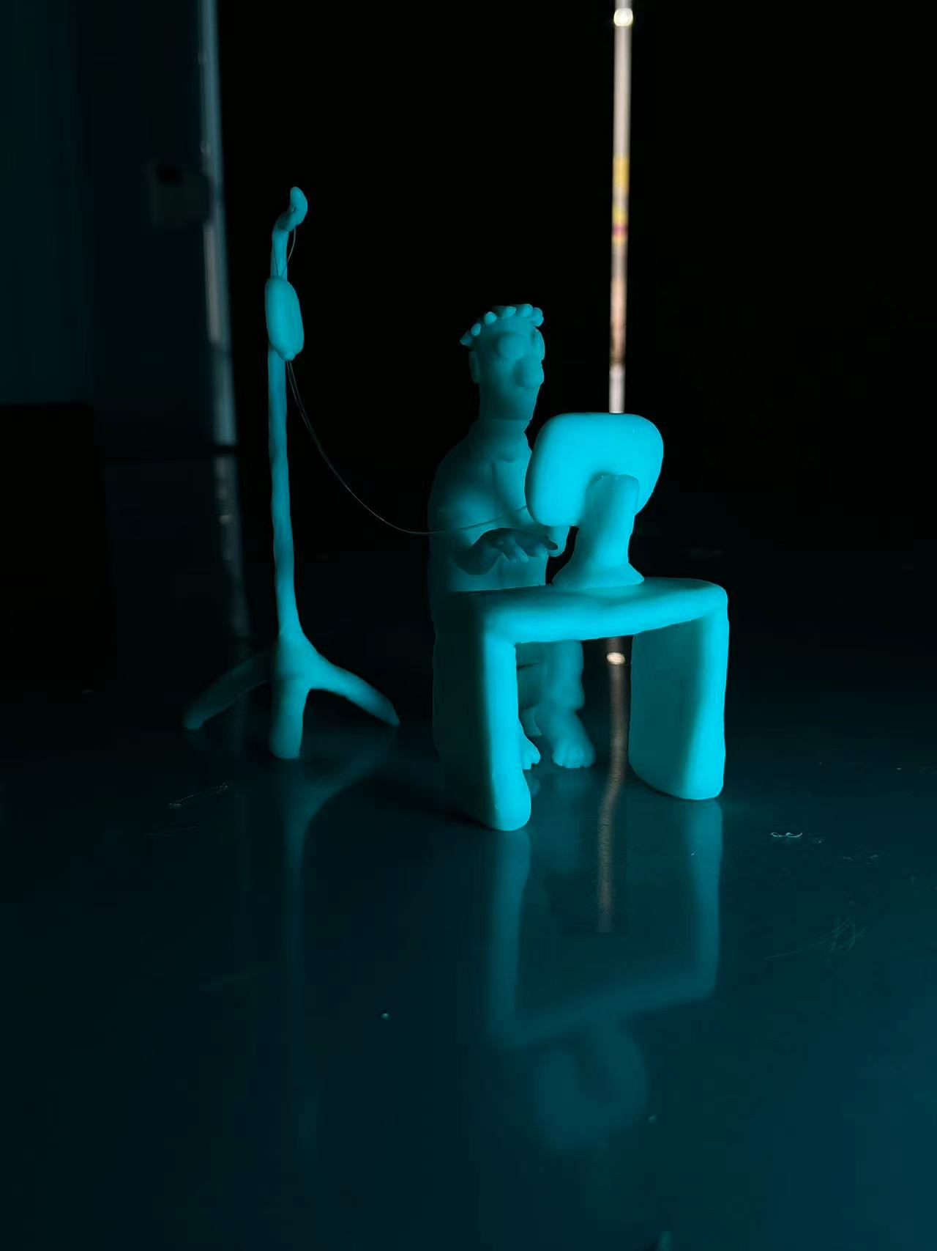
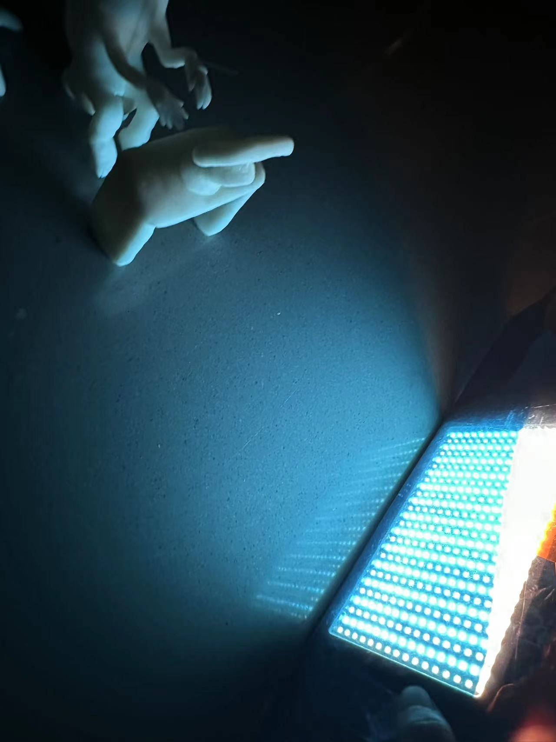
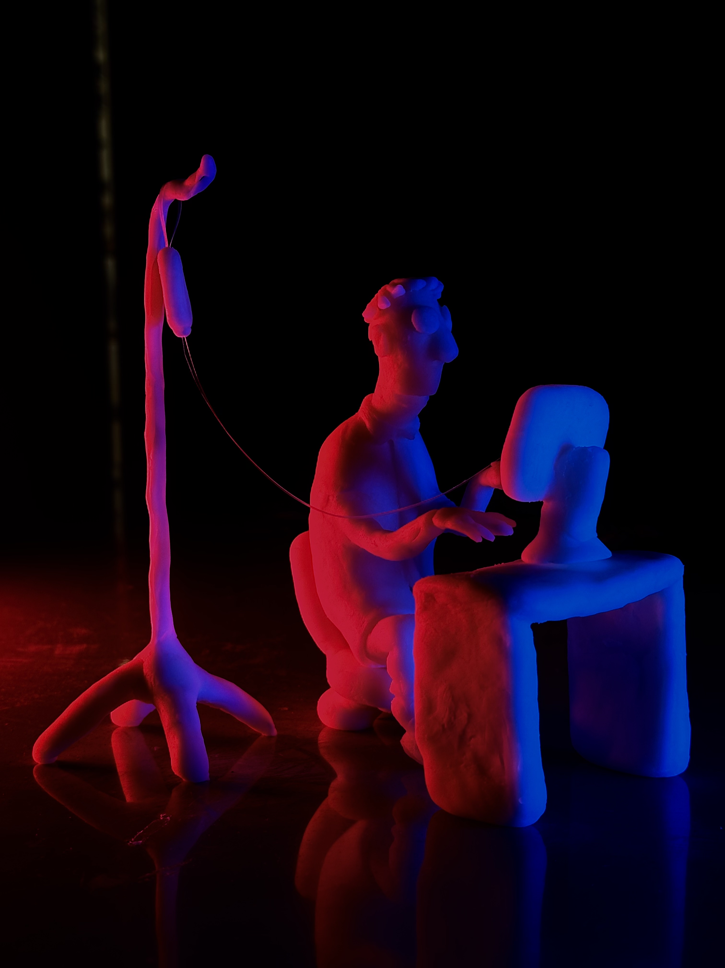
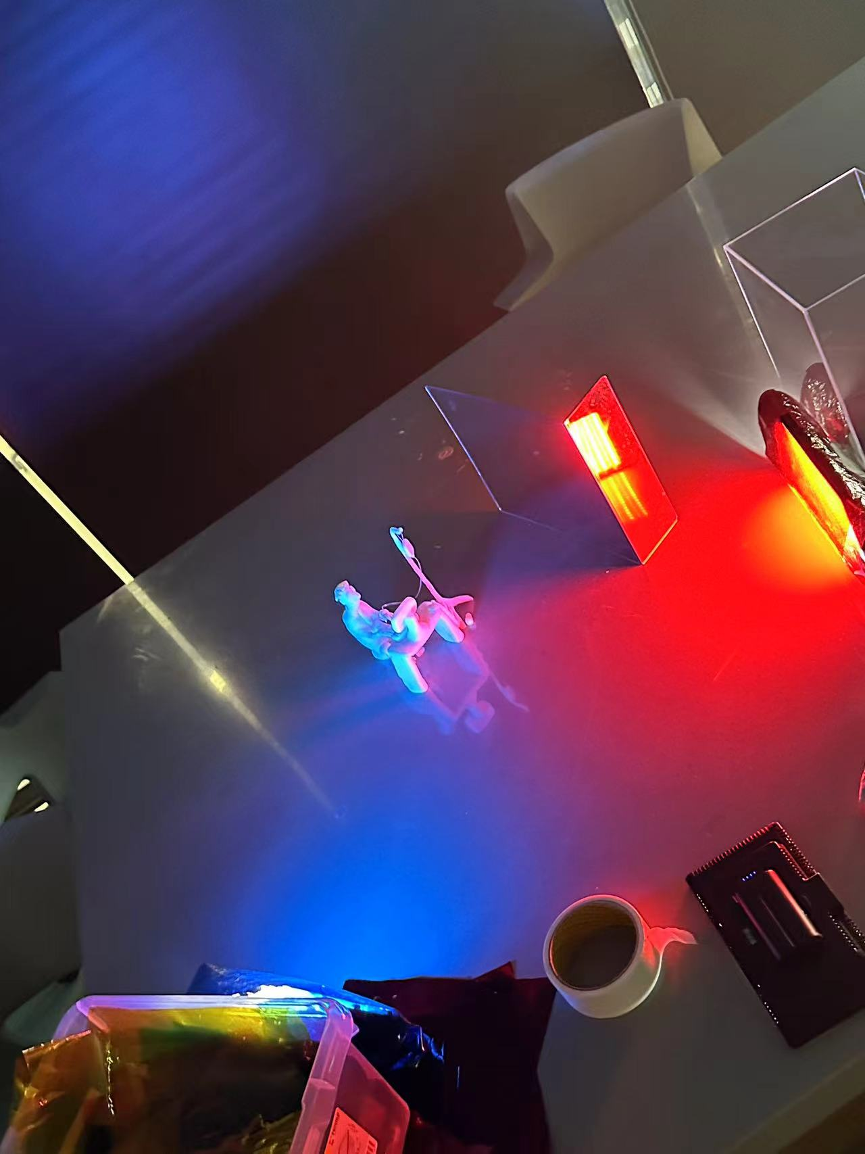
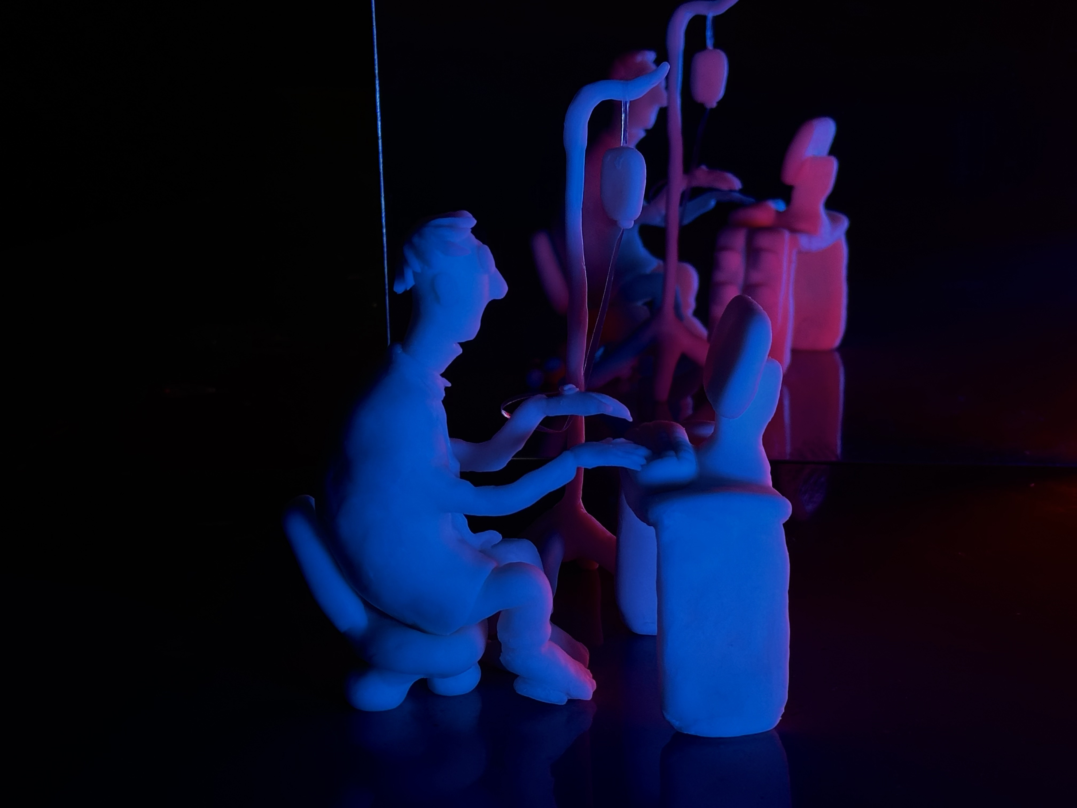
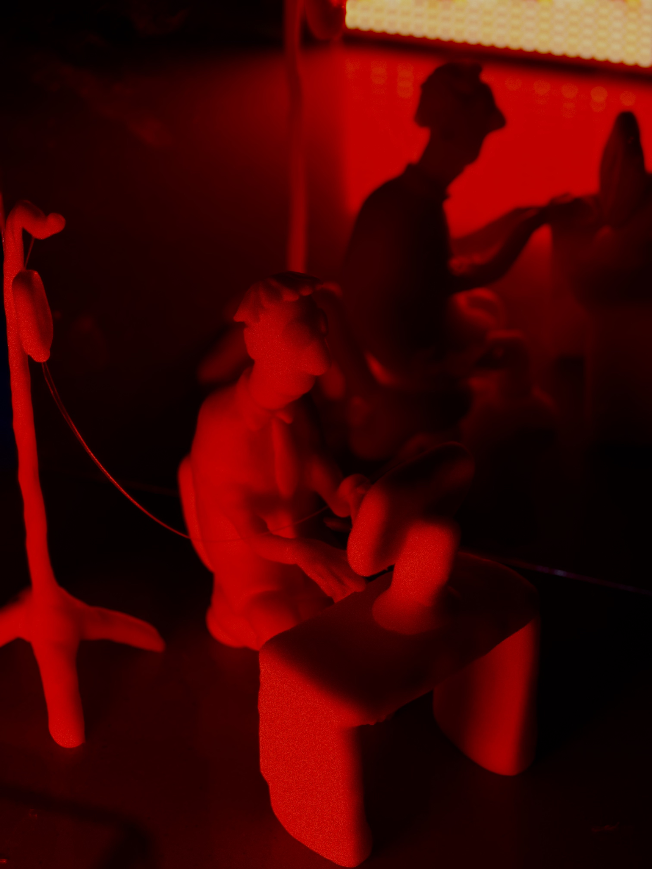
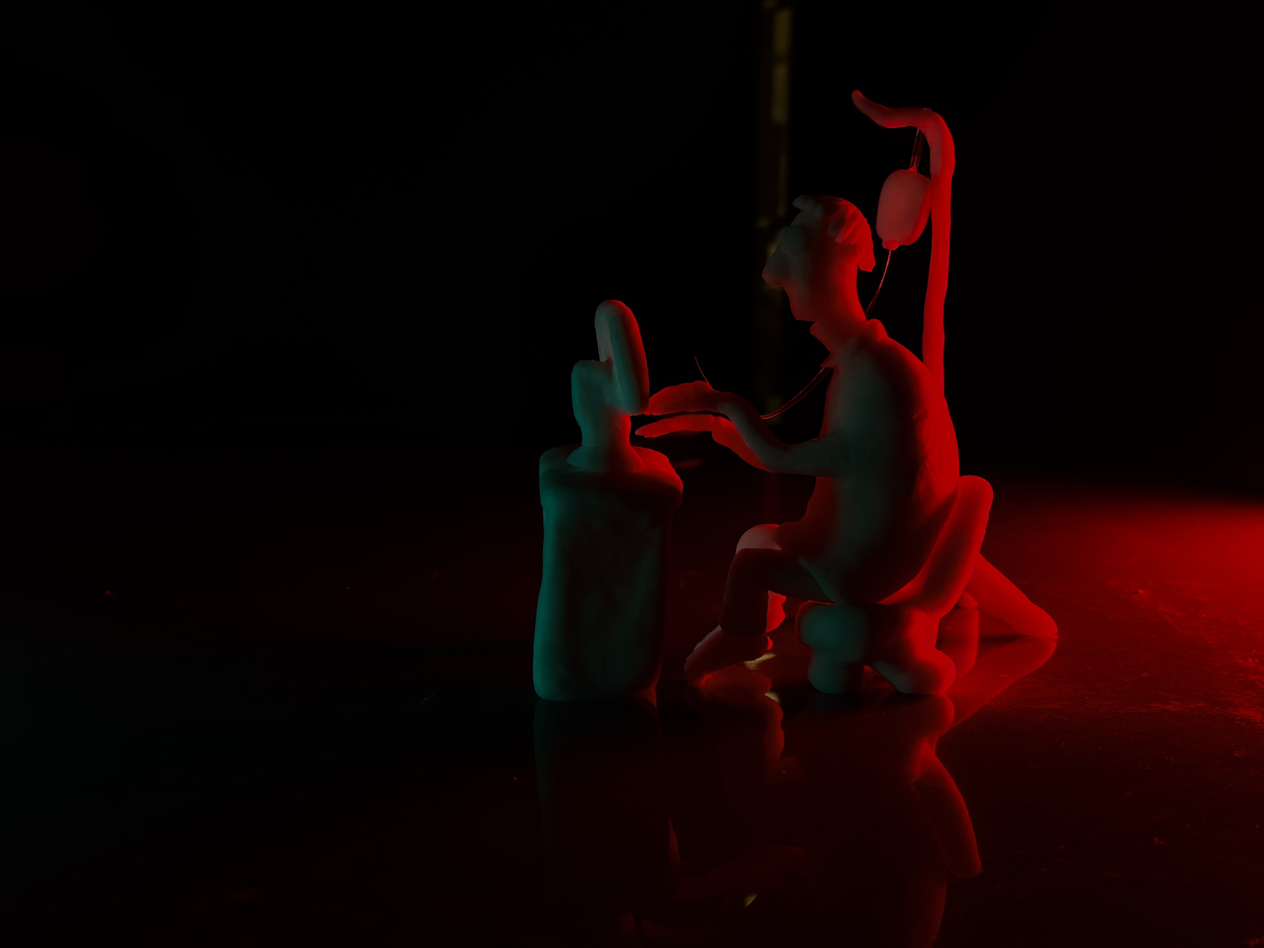
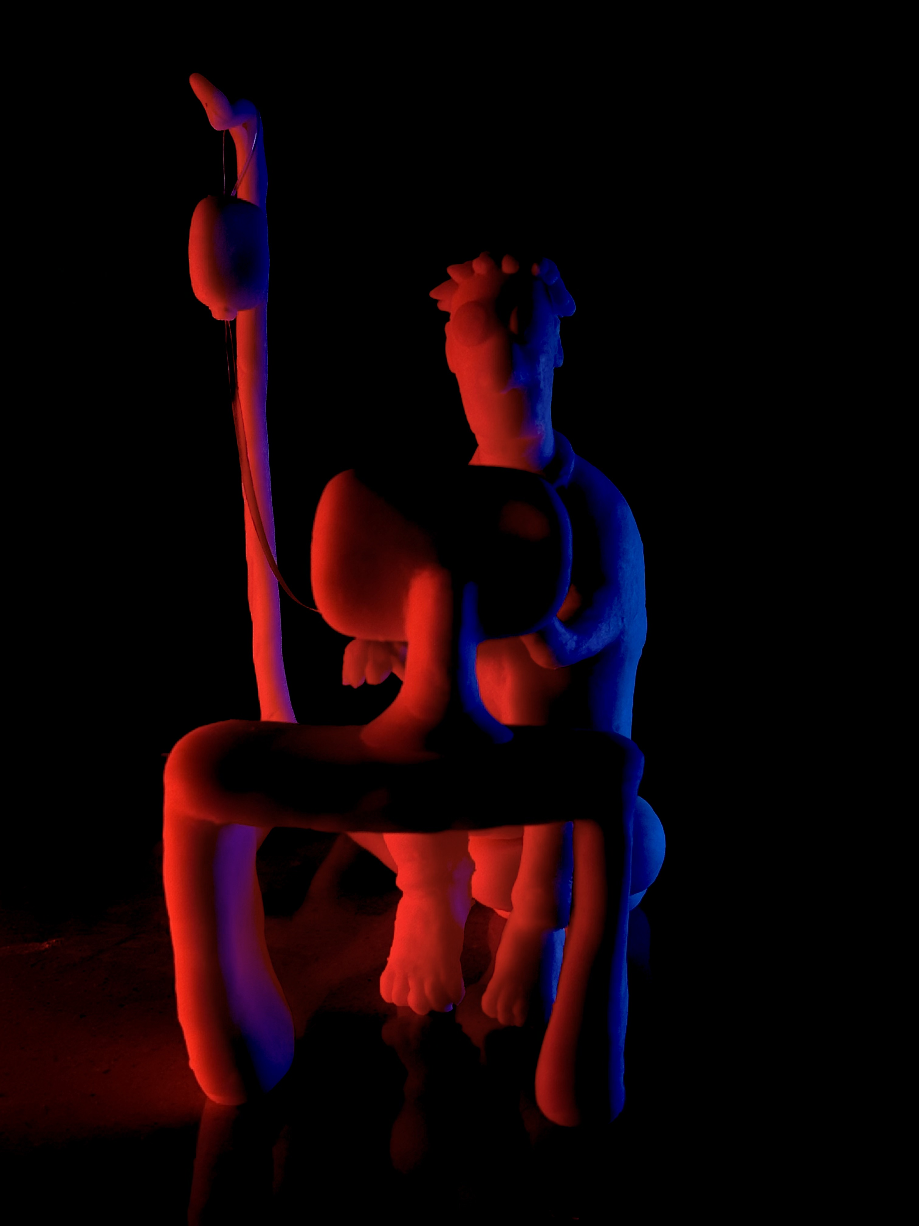
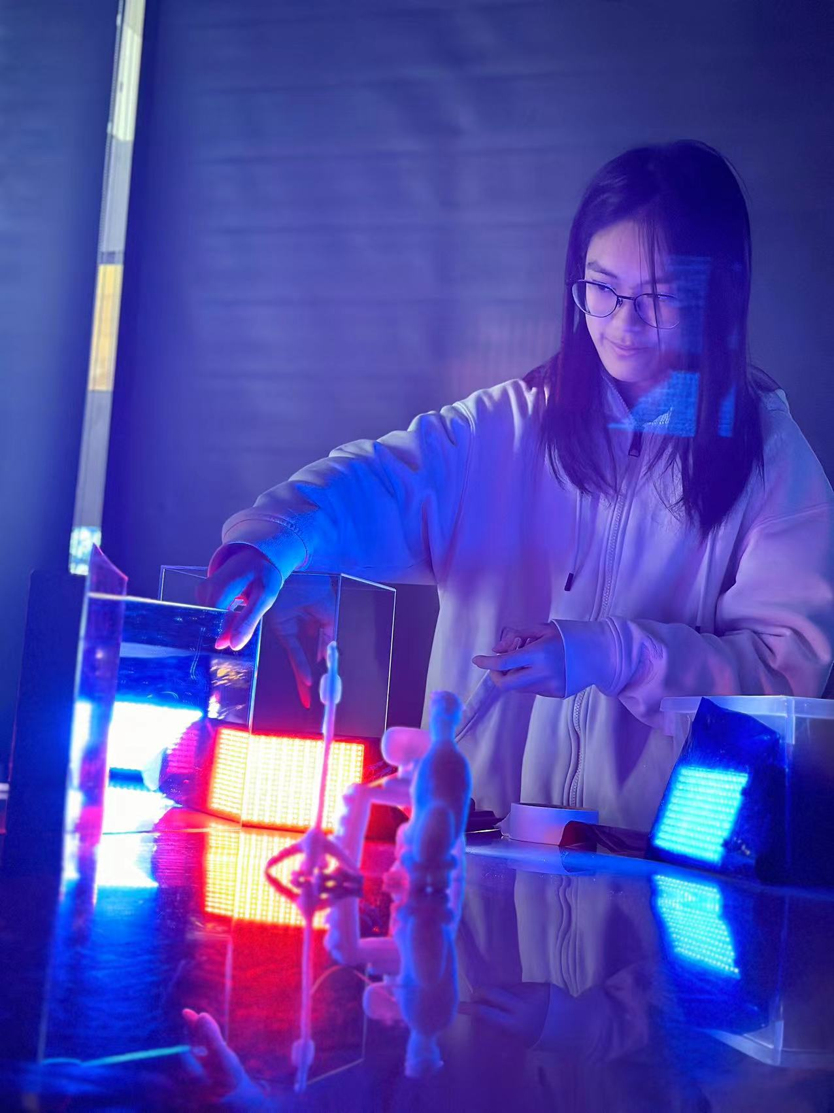
PROCESSING
Experimentation of different color light
The following show my experimentation of single color light, I cover the light with different color film paper creating different effect (yellow blue and red light)
Double lighting , because the effect is best created by using blue and red (single light) so I combined the two color light and it gave a more complex feeling and effect.
By placing the light source in different position it give out different effect. As we can see the firts image, there are two color of people the red one is the form the mirrow and the blue one is the clay one. It can be readed as the red person is a warning, saying if the person still working with out rest, he will probably die very soon.
Form the experiment of single light I realize that yellow light cannot create the feeling that I want, yellow light gives more a feeling of warm and pleasant mood. While the red and the blue light is creating other different feelings. For example blue light is more cold and emotionless, while the red light is more powerful and gives the audience a feeling of nervousness and anxiousness.
During the experiment of lighting I also find out that the distance between the film paper and the light source can create different effect, for example you can see at the forth picture on the front row the film paper is a little off form the light so the color of light on the clay is lighter.
For the red light photo on the left, we observe it looks like that there are two people, because I use a mirror to make a shadow of the person .

Slide 6
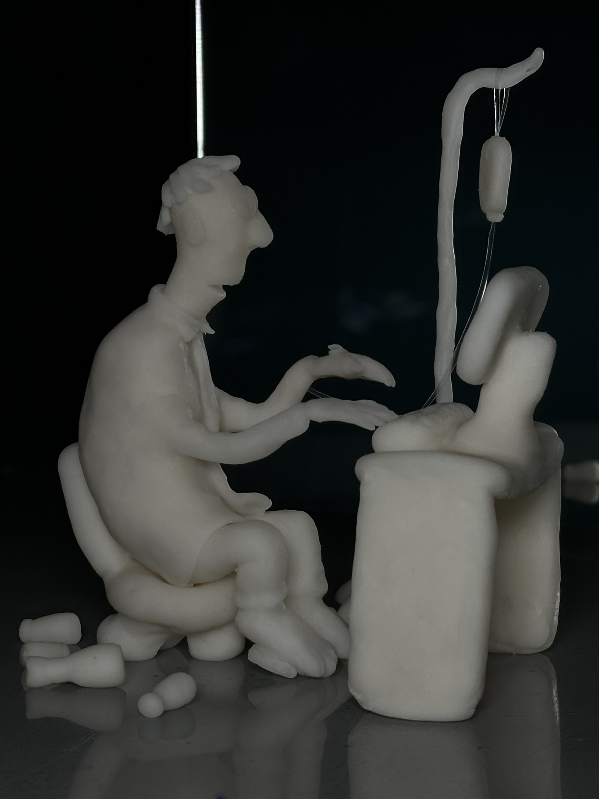
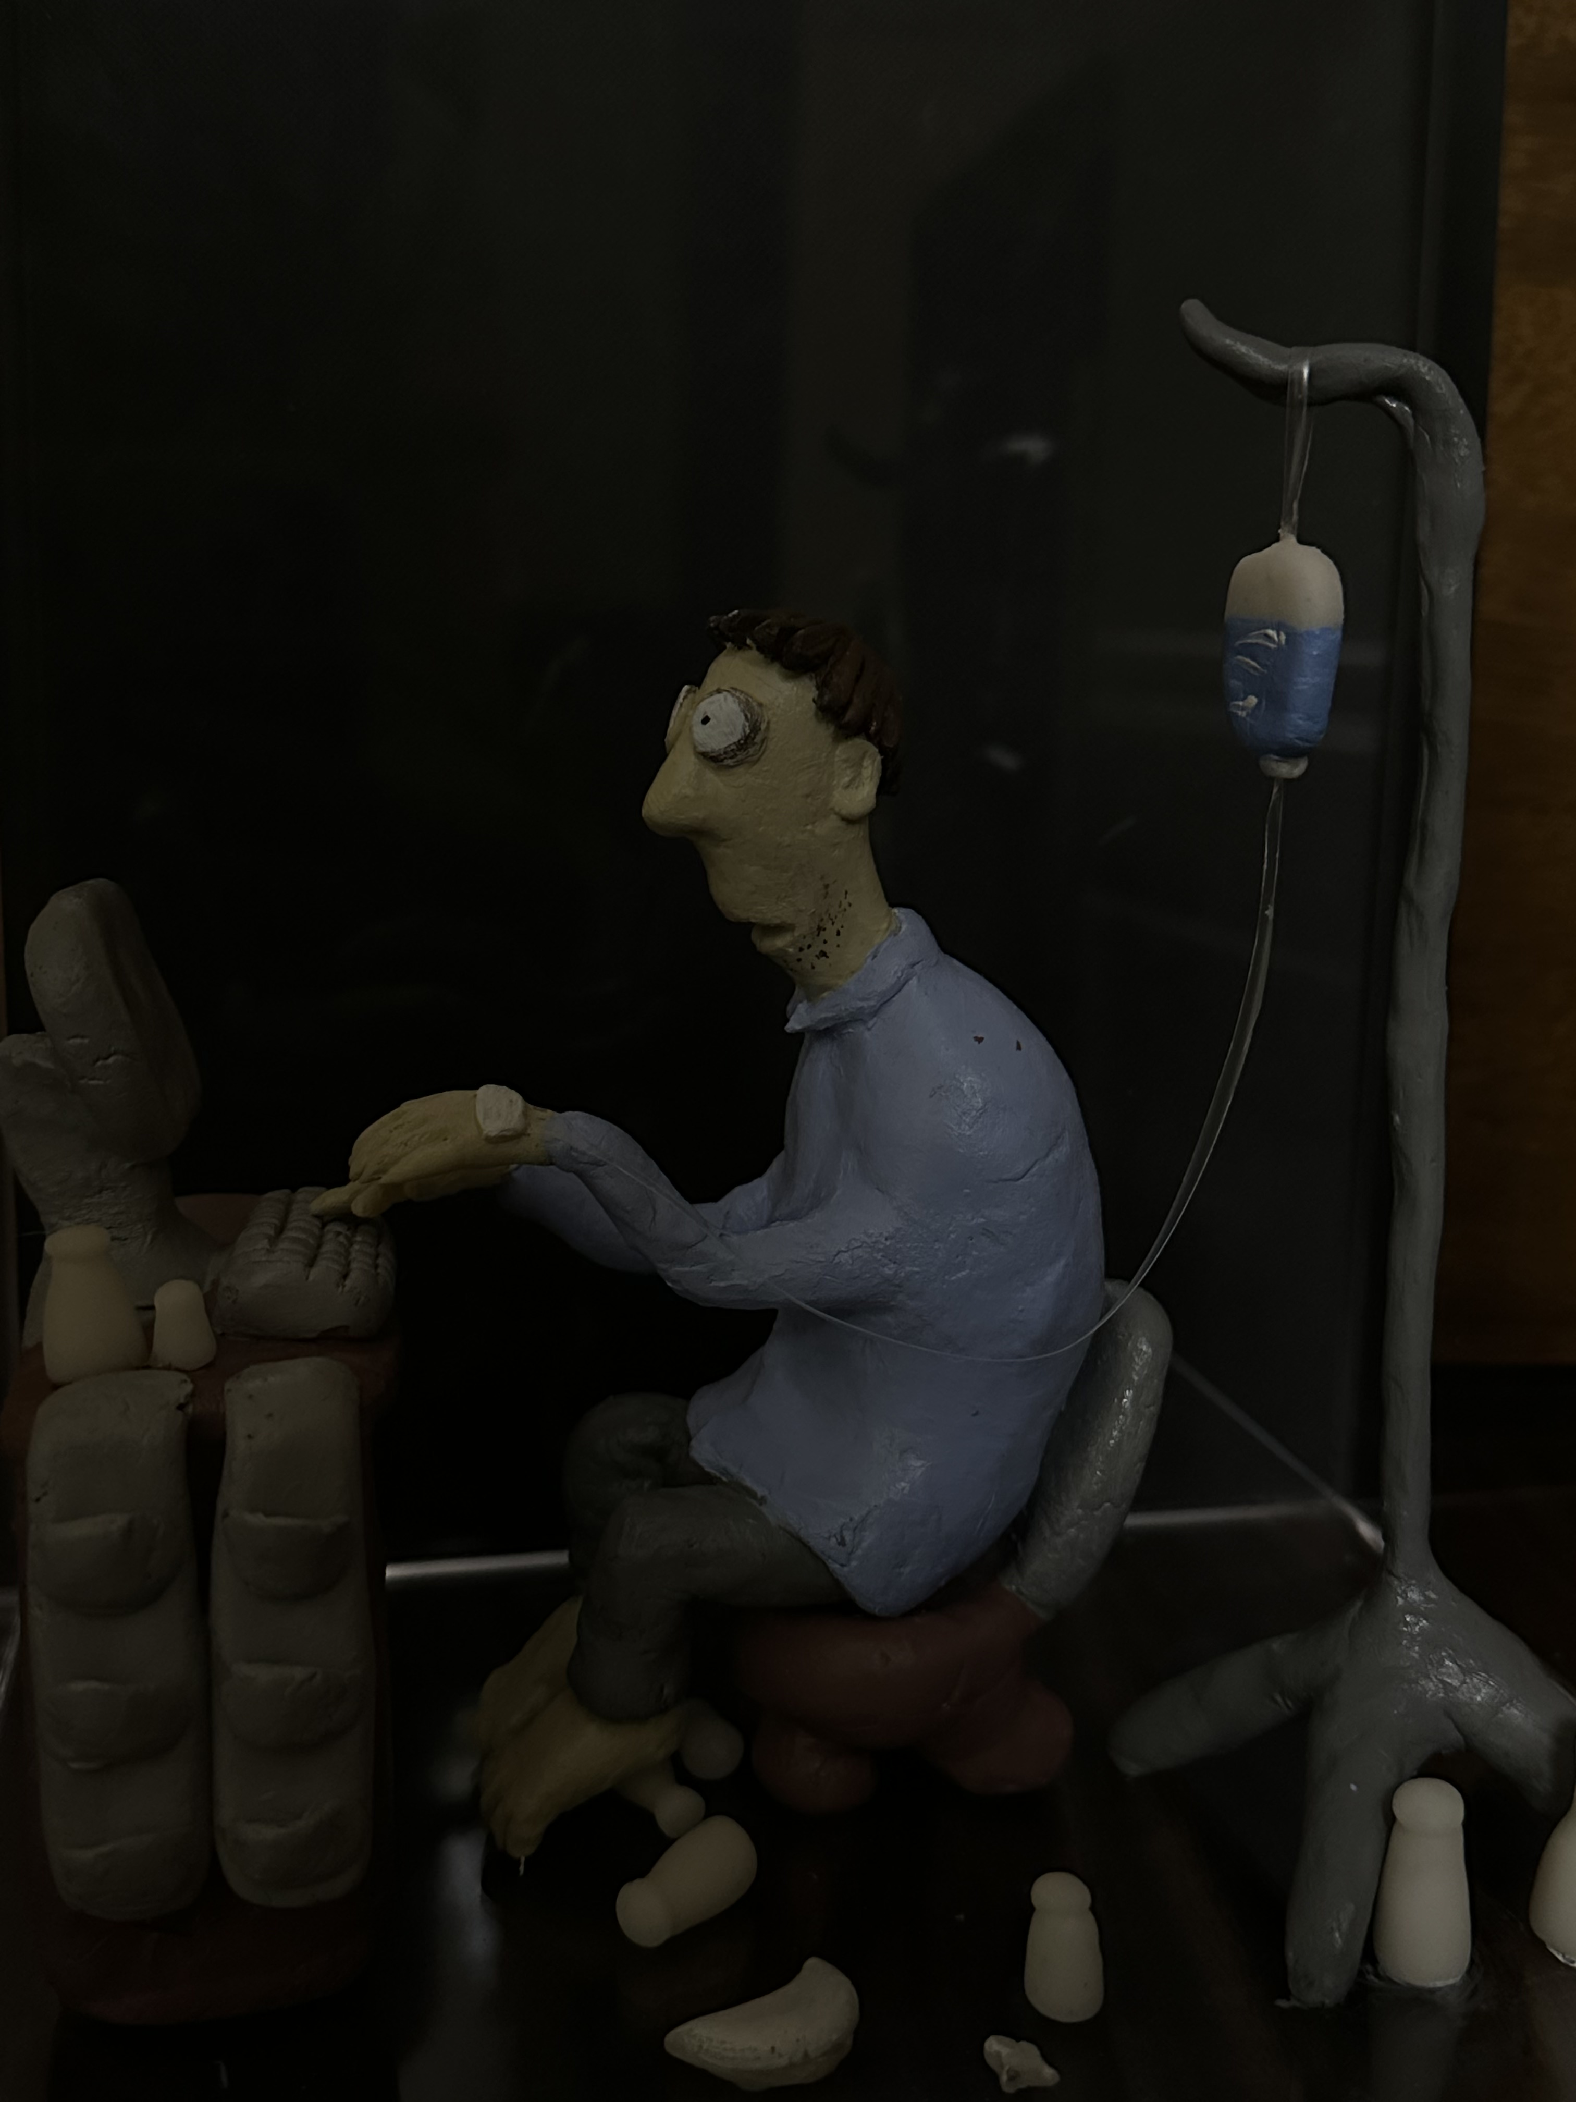
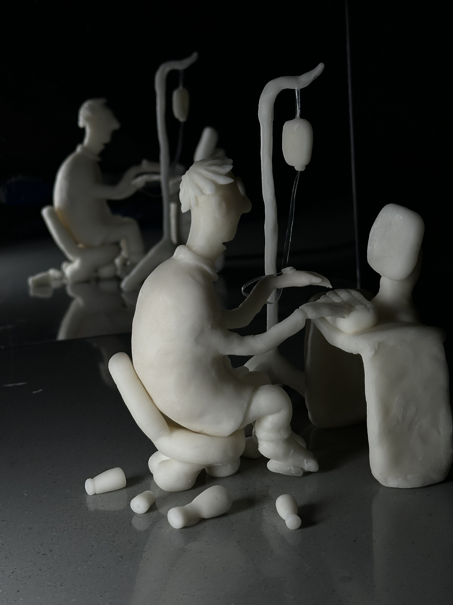
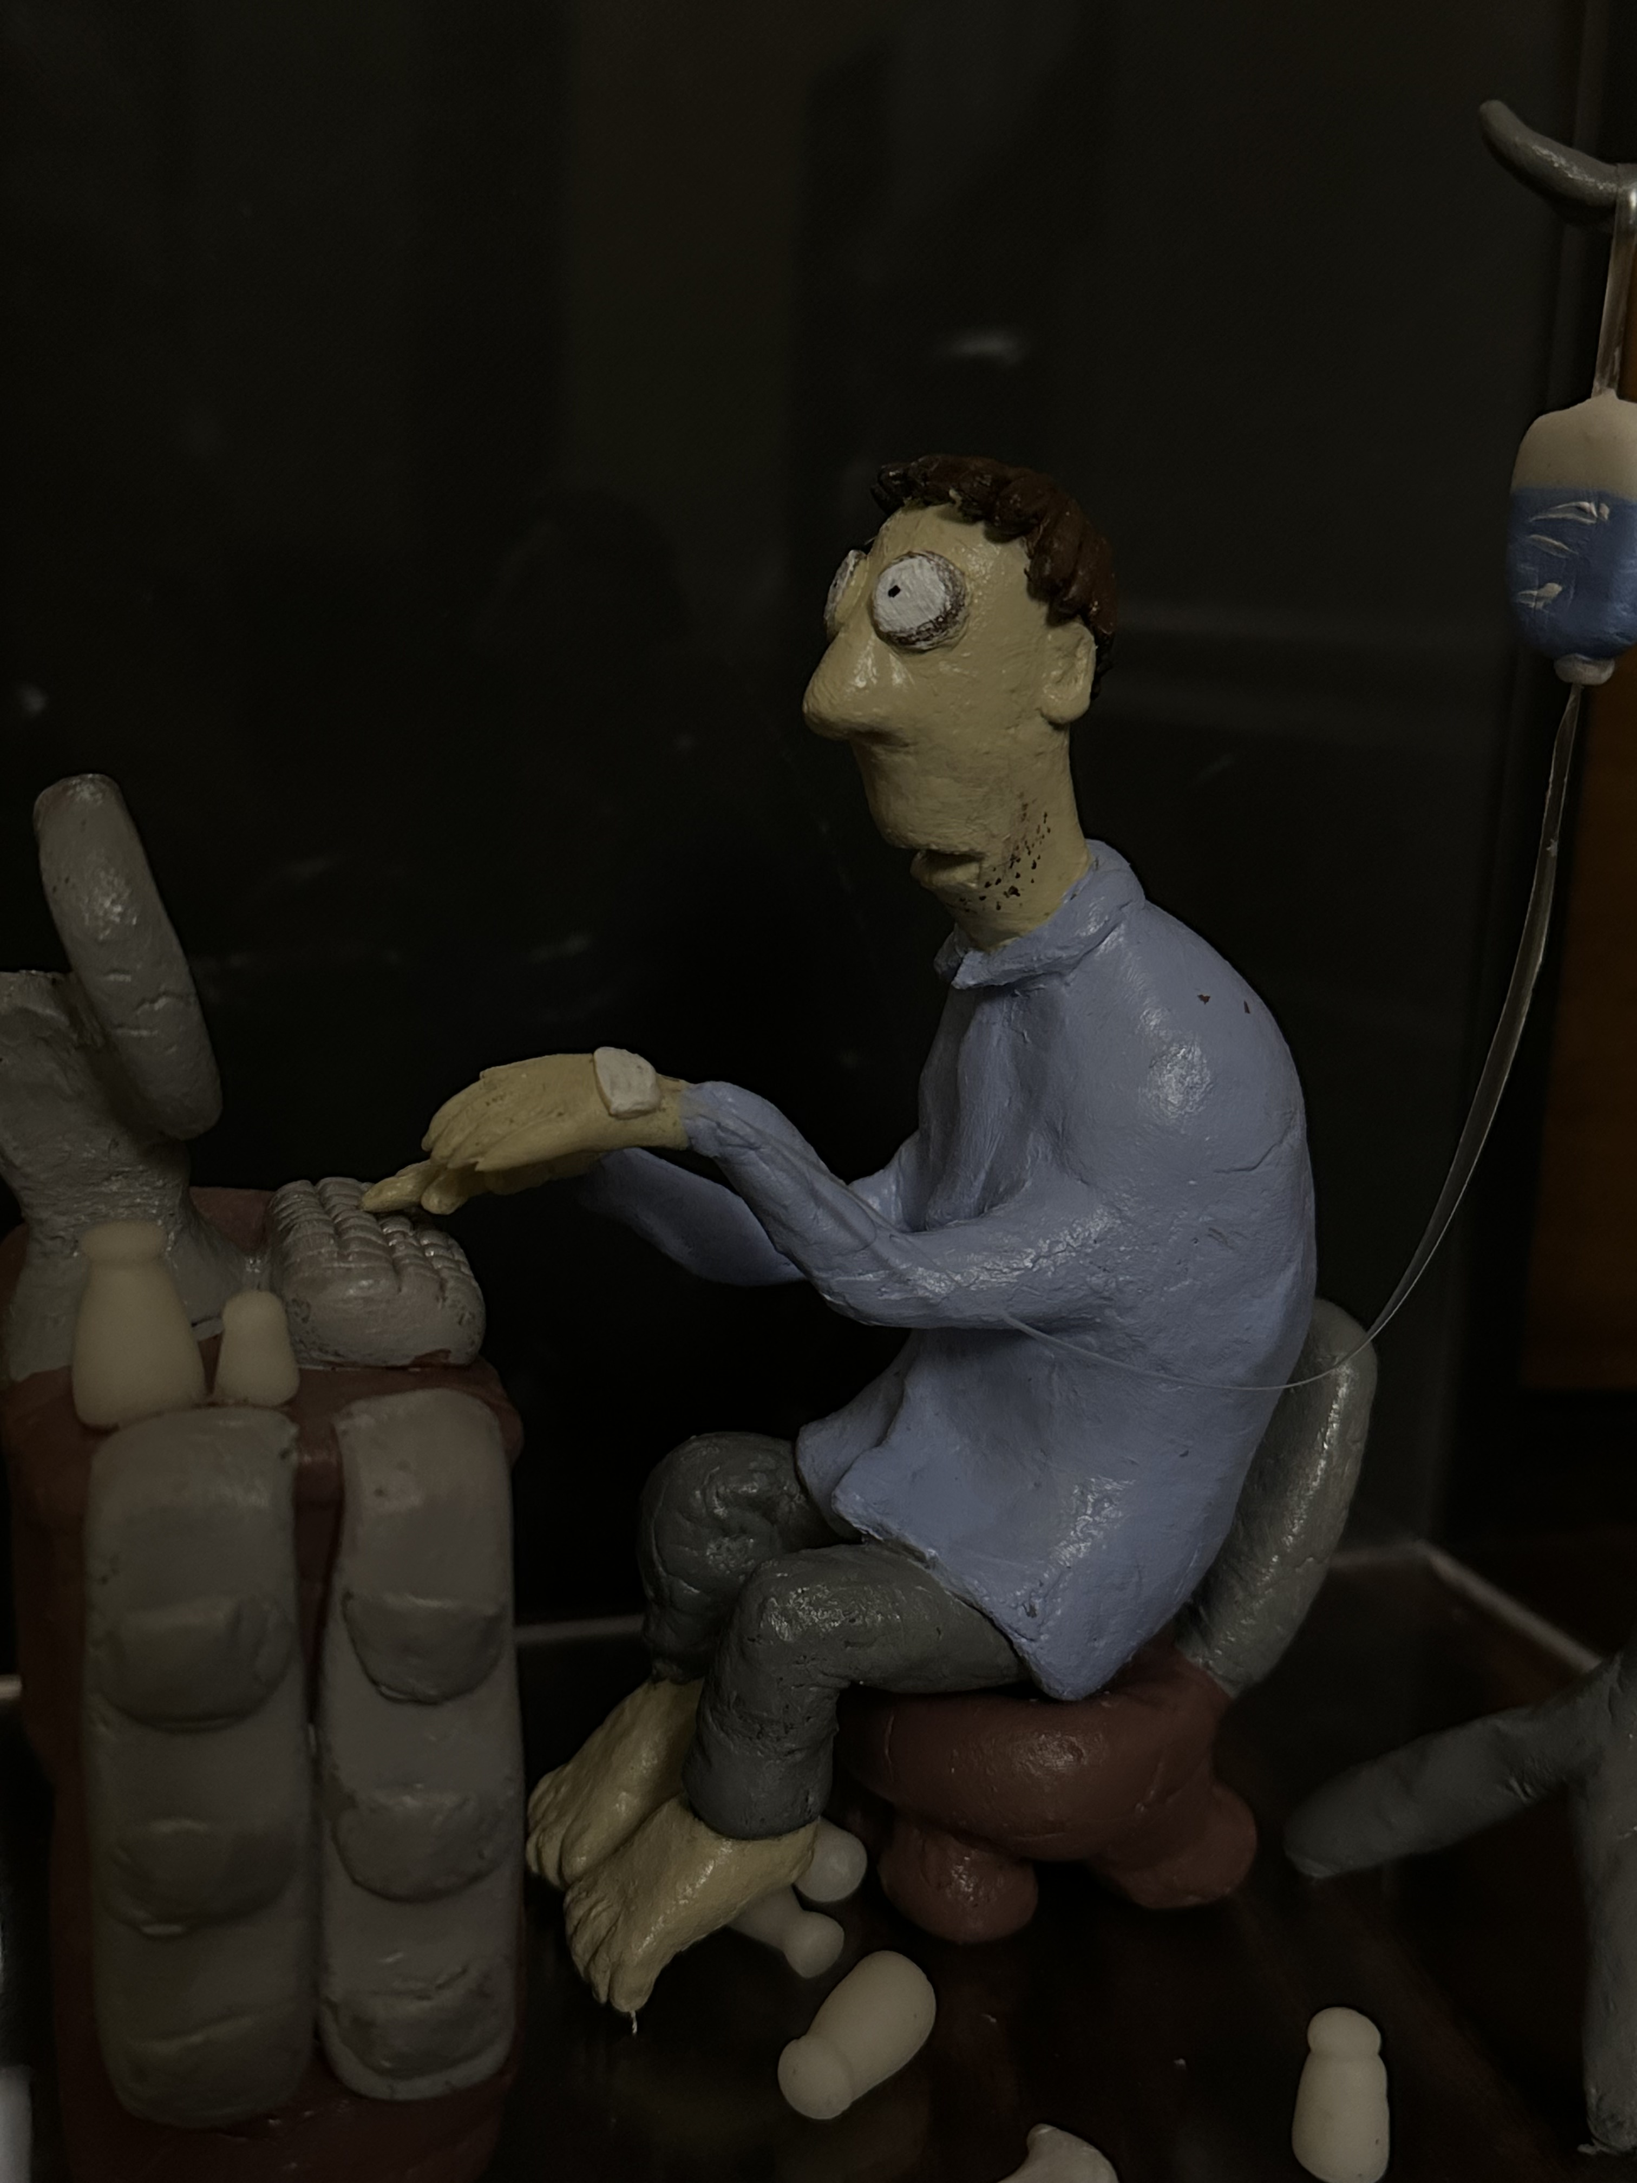
Final work
I also took picture of the clay without light and without paint, it adress more direct and pure imformation about the theme working load. People under pressure they do not have color they are blanc they cannot have their hobbies, their thought all they should do is to follow the rules that their boss want them to do, and no one care about if they are sick or not
Strenght of my work is presenting my project in different ways and give different feelings
I learned how to use different light to create the atmosphere that I want to present. I leaned how to use clay to create three dimentional projects effectively present the idea that I want the audience to receive . What I can improve, I think is can use wire for the table.
I tookpicture of the clay wit light and without paint, it adress more about the atmosphere of exhaustion and the limited ability of the mans’ body to carry this work load different color light shows that the man is working extremely and his body is also at the limite line from suffer.
The painted version of the person shows a different feeling to the previous one, referecing to the color that pissarro used in the his painting, the color of his shirt is the similar to the color of the sky, the color of the desk and chair is similar to the color of the hay stack. The emotion of the person is represented more direct on the painted version, because we can observe the dark circle of his eyes. And the depress emotion.

